Slide 1
Advanced Data Structures and Algorithms
Advanced Data Structures and Algorithms
Lecture 10 – Bipartite Graph
Miao Zhang
Resource: http://wangshusen.github.io/

Slide 2
Definition

Slide 3
Bipartite Graph
𝑢₁
𝑣₁
• Bipartite graph: 𝒢 = 𝒰, 𝒱, ℰ .
𝑢₂
𝑣₂
𝑢₃
𝑣₃
𝑢₄
𝑣₄
Set 𝒱
𝑢₅
Set 𝒰

Slide 4
Bipartite Graph
𝑢₁
𝑣₁
• Bipartite graph: 𝒢 = 𝒰, 𝒱, ℰ .
• All the edges are between 𝒰 and 𝒱.
• No edge between two vertices in 𝒰
• No edge between two vertices in 𝒱.
𝑢₂
𝑣₂
𝑢₃
𝑣₃
𝑢₄
𝑣₄
Set 𝒱
𝑢₅
Set 𝒰

Slide 5










Candidates
Positions
Matching candidates and positions.
Alice
• Bipartite graph: 𝒢 = 𝒰, 𝒱, ℰ .
• Set 𝒰 contains candidates.
• Set 𝒱 contains jobs.
• Edges in ℰ are candidates’ skills.
Bob
Chris
David
Emma

Slide 6
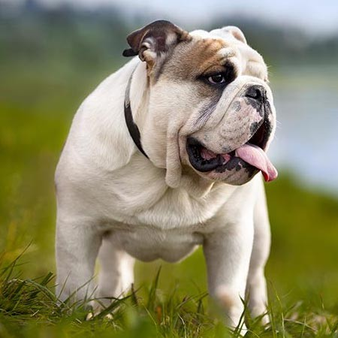
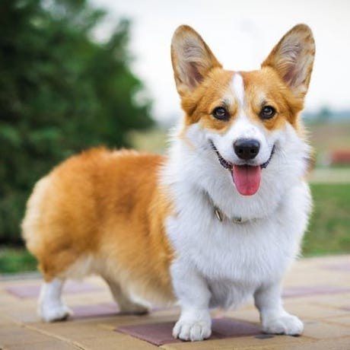
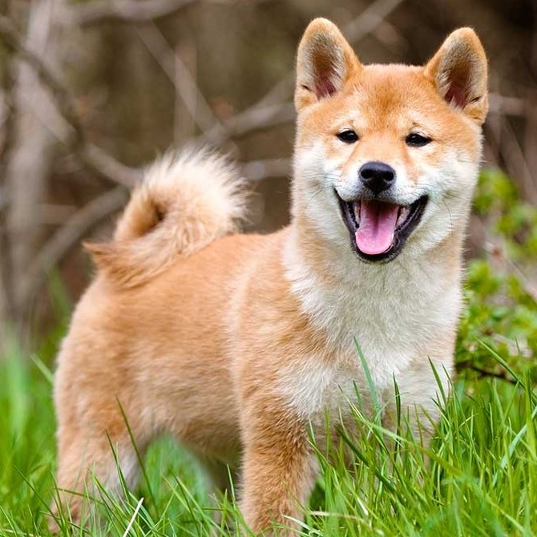

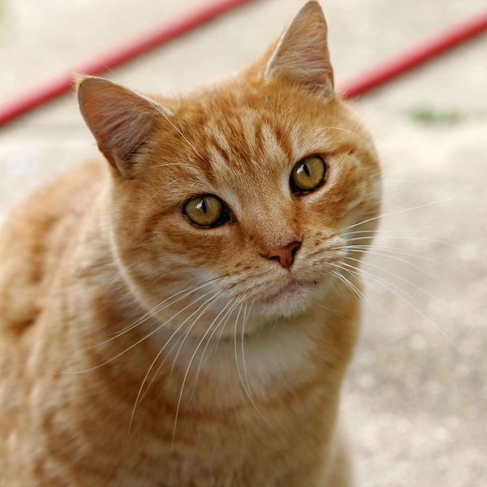
People
Pets
Pet adoption
Alice
• Bipartite graph: 𝒢 = 𝒰, 𝒱, ℰ .
• Set 𝒰 contains people.
• Set 𝒱 contains pets.
• Edges in ℰ are people’s preference.
Bob
Chris
David
Emma

Slide 7





Women
Men
Dating
Alex
Alice
• Bipartite graph: 𝒢 = 𝒰, 𝒱, ℰ .
• Set 𝒰 contains males.
• Set 𝒱 contains females.
• Edges in ℰ are people’s preference.
Bob
Becky
Chris
Cindy
David
Diana
Eli
Emma

Slide 8
Testing Bipartiteness

Slide 9
Is the graph bipartite?
1. Select an arbitrary vertex and assign red color to it.
2. Repeat until all vertices are colored:
• Color red vertices’ neighbors as blue.
• Color blue vertices’ neighbors as red.
• During the process, if a vertex has the same color as its neighbor, then output FALSE.
3. If no violation is found, return TRUE in the end.
𝑣₁
𝑣₂
𝑣₆
𝑣₃
𝑣
𝑣
5
4

Slide 10
Example 1
1. Select any vertex and assign red color to it.
𝑣₁
𝑣₂
𝑣₆
𝑣₃
𝑣₅
𝑣₄

Slide 11
Example 1
1. Select any vertex and assign red color to it.
2. Color red vertices’ neighbors as blue.
𝑣₁
𝑣₂
𝑣₆
𝑣₃
𝑣₅
𝑣₄

Slide 12
Example 1
1. Select any vertex and assign red color to it.
2. Color red vertices’ neighbors as blue.
3. Color blue vertices’ neighbors as red.
𝑣₁
𝑣₂
𝑣₆
𝑣₃
𝑣₅
𝑣₄

Slide 13
Example 1
1. Select any vertex and assign red color to it.
2. Color red vertices’ neighbors as blue.
3. Color blue vertices’ neighbors as red.
4. Color red vertices’ neighbors as blue.
𝑣₁
𝑣₂
𝑣₆
𝑣₃
𝑣₅
𝑣₄

Slide 14
Example 1
𝑣₁
𝑣₂
• No violation has been found!
• It is bipartite graph.
𝑣₆
𝑣₃
𝑣₅
𝑣₄

Slide 15
Example 2
𝑣₁
𝑣₂
𝑣₆
𝑣₃
𝑣₅
𝑣₄

Slide 16
Example 2
1. Select any vertex and assign red color to it.
𝑣₁
𝑣₂
𝑣₆
𝑣₃
𝑣₅
𝑣₄

Slide 17
Example 2
1. Select any vertex and assign red color to it.
2. Color red vertices’ neighbors as blue.
𝑣₁
𝑣₂
𝑣₆
𝑣₃
𝑣₅
𝑣₄

Slide 18
Example 2
1. Select any vertex and assign red color to it.
2. Color red vertices’ neighbors as blue.
3. Color blue vertices’ neighbors as red.
𝑣₁
𝑣₂
𝑣₆
𝑣₃
𝑣₅
𝑣₄

Slide 19
Example 2
𝑣₁
𝑣₂
• Violation found!
• It is not bipartite graph.
𝑣₆
𝑣₃
Violation!
𝑣₅ 𝑣₄
Violation!

Slide 20
Example 3
𝑣₁
𝑣₂
𝑣₃
𝑣₄
𝑣₅
𝑣₆
𝑣₇
𝑣₈
𝑣₉
^{𝑣}10

Slide 21
Example 3
1. Select any vertex and assign red color to it.
𝑣₁
𝑣₂
𝑣₃
𝑣₄
𝑣₅
𝑣₆
𝑣₇
𝑣₈
𝑣₉
^{𝑣}10

Slide 22
Example 3
1. Select any vertex and assign red color to it.
2. Color red vertices’ neighbors as blue.
𝑣₁
𝑣₂
𝑣₃
𝑣₄
𝑣₅
𝑣₆
𝑣₇
𝑣₈
𝑣₉
^{𝑣}10

Slide 23
Example 3
1. Select any vertex and assign red color to it.
2. Color red vertices’ neighbors as blue.
3. Color blue vertices’ neighbors as red.
𝑣₁
𝑣₂
𝑣₃
𝑣₄
𝑣₅
𝑣₆
𝑣₇
𝑣₈
𝑣₉
^{𝑣}10

Slide 24
Example 3
1. Select any vertex and assign red color to it.
2. Color red vertices’ neighbors as blue.
3. Color blue vertices’ neighbors as red.
4. Color red vertices’ neighbors as blue.
𝑣₁
𝑣₂
𝑣₃
𝑣₄
𝑣₅
𝑣₆
𝑣₇
𝑣₈
𝑣₉
^{𝑣}10

Slide 25
Example 3
𝑣₁
𝑣₂
• Violation found!
• It is not bipartite graph.
𝑣₃
𝑣₄
𝑣₅
𝑣₆
𝑣₇
𝑣₈
𝑣₉
^{𝑣}10
Violation!

Slide 26
Algorithm Details

Slide 27
Is the graph bipartite?
𝑣₁
𝑣₂
𝑣₅
𝑣₆
𝑣₈
𝑣₇
𝑣₄
𝑣₃

Slide 28
Initial State
Queue:
𝑣₁
𝑣₂
𝑣₅
𝑣₆
𝑣₈
𝑣₇
𝑣₄
𝑣₃

Slide 29
Initial State
Queue:
𝑣₁
𝑣₂
• Assign red color to 𝑣₁.
𝑣₅
𝑣₆
𝑣₈
𝑣₇
𝑣₄
𝑣₃

Slide 30
Initial State
Queue:
• Assign red color to 𝑣₁.
• enqueue 𝑣₁ .
𝑣₁
𝑣₂
𝑣₁
𝑣
𝑣
5
6
𝑣₈
𝑣₇
𝑣₄
𝑣₃

Slide 31
Iteration 1
Queue:
𝑣₁
𝑣₂
• 𝑣₁
➛ dequeue( ).
𝑣₁
𝑣₅
𝑣₆
𝑣₈
𝑣₇
𝑣₄
𝑣₃

Slide 32
Iteration 1
Queue:
• 𝑣₁ ➛ dequeue( ).
• Assign blue color to its unvisited neighbors, 𝑣₂, 𝑣₄, and 𝑣₅.
𝑣₁
𝑣₂
𝑣₅
𝑣₆
𝑣₈ 𝑣₇
𝑣₃
𝑣₄

Slide 33
Iteration 1
Queue:
• 𝑣₁ ➛ dequeue( ).
• Assign blue color to its unvisited neighbors, 𝑣₂, 𝑣₄, and 𝑣₅.
• Put the unvisited neighbors, 𝑣₂, 𝑣₄, and 𝑣₅, in the queue.
𝑣₁
𝑣₂
𝑣₂
𝑣₄
𝑣₅
𝑣₅
𝑣₆
𝑣₈ 𝑣₇
𝑣₃
𝑣
4

Slide 34
Iteration 2
Queue:
𝑣₁
𝑣₂
• 𝑣₂
➛ dequeue( ).
𝑣₂
𝑣₄
𝑣₅
𝑣₅
𝑣₆
𝑣₈
𝑣₇
𝑣₄
𝑣₃

Slide 35
Iteration 2
Queue:
𝑣₁
𝑣₂
• 𝑣₂
➛ dequeue( ).
𝑣₄
𝑣₅
𝑣₆
𝑣₅
𝑣₈ 𝑣₇
𝑣₄
𝑣₃

Slide 36
Iteration 2
No violation
Queue:
𝑣
𝑣
• 𝑣 ➛ dequeue( ).
1
2
2
𝑣₄
𝑣₅
• Check the visited neighbors to see if there is any violation.
𝑣₆
𝑣₅
𝑣₈ 𝑣₇
𝑣₄
𝑣₃

Slide 37
Iteration 2
Queue:
• 𝑣₂ ➛ dequeue( ).
• Check the visited neighbors to see if there is any violation.
• Assign red color to its neighbors, 𝑣₃ and 𝑣₆.
𝑣₁
𝑣₂
𝑣₄
𝑣₅
𝑣₆
𝑣₅
𝑣₈ 𝑣₇
𝑣₄
𝑣₃

Slide 38
Iteration 2
Queue:
• 𝑣₂ ➛ dequeue( ).
• Check the visited neighbors to see if there is any violation.
• Assign red color to its neighbors, 𝑣₃ and 𝑣₆.
• Put the unvisited neighbors, 𝑣₃ and 𝑣₆, in the queue.
𝑣₁
𝑣₂
𝑣₄
𝑣₅
𝑣₃
𝑣₆
𝑣₆
𝑣₅
𝑣₈ 𝑣₇
𝑣₄
𝑣₃

Slide 39
Iteration 3
Queue:
𝑣₁
𝑣₂
• 𝑣₄
➛ dequeue( ).
𝑣₄
𝑣₅
𝑣₃
𝑣₆
𝑣₅
𝑣₆
𝑣₈
𝑣₇
𝑣₄
𝑣₃

Slide 40
Iteration 3
Queue:
𝑣₁
𝑣₂
𝑣₅ 𝑣₆
𝑣₇
• 𝑣₄
➛ dequeue( ).
𝑣₅
𝑣₃
𝑣₆
𝑣₈
𝑣₄
𝑣₃

Slide 41
Iteration 3
Queue:
• 𝑣₄ ➛ dequeue( ).
• Check the visited neighbors to see if there is any violation.
𝑣₁
𝑣₂
𝑣₅ 𝑣₆
𝑣₇
𝑣₅
𝑣₃
𝑣₆
𝑣₈
𝑣₄
𝑣₃
No violation

Slide 42
Iteration 3
Queue:
• 𝑣₄ ➛ dequeue( ).
• Check the visited neighbors to see if there is any violation.
• Assign red color to its neighbor, 𝑣₈.
𝑣₁
𝑣₂
𝑣₅ 𝑣₆
𝑣₇
𝑣₅
𝑣₃
𝑣₆
𝑣₈
𝑣₄
𝑣₃

Slide 43
Iteration 3
Queue:
• 𝑣₄ ➛ dequeue( ).
• Check the visited neighbors to see if there is any violation.
• Assign red color to its neighbor, 𝑣₈.
• Put the unvisited neighbor, 𝑣₈, in the queue.
𝑣₁
𝑣₂
𝑣₅ 𝑣₆
𝑣₇
𝑣₅
𝑣₃
𝑣₆
𝑣₈
𝑣₈
𝑣₄
𝑣₃

Slide 44
Iteration 4
Queue:
𝑣₁
𝑣₂
• 𝑣₅
➛ dequeue( ).
𝑣₅
𝑣₃
𝑣₆
𝑣₈
𝑣₅
𝑣₆
𝑣₈
𝑣₇
𝑣₄
𝑣₃

Slide 45
Iteration 4
Queue:
𝑣₁
• 𝑣₅
➛ dequeue( ).
𝑣₂
𝑣₇
𝑣₄ 𝑣₃
𝑣₃
𝑣₆
𝑣₈
𝑣₅
𝑣₆
𝑣₈

Slide 46
Iteration 4
Queue:
• 𝑣₅ ➛ dequeue( ).
• Check the visited neighbors to see if there is any violation.
𝑣₁
𝑣₂
𝑣₇
𝑣₄ 𝑣₃
No violation
𝑣₃
𝑣₆
𝑣₈
𝑣₅ 𝑣₆
𝑣₈

Slide 47
Iteration 4
Queue:
• 𝑣₅ ➛ dequeue( ).
• Check the visited neighbors to see if there is any violation.
• Do not put visited neighbors in the queue.
𝑣₁
𝑣₂
𝑣₇
𝑣₄ 𝑣₃
𝑣₃
𝑣₆
𝑣₈
𝑣₅
𝑣₆
𝑣₈

Slide 48
Iteration 5
Queue:
𝑣₁
𝑣₂
• 𝑣₃
➛ dequeue( ).
𝑣₃
𝑣₆
𝑣₈
𝑣₅
𝑣₆
𝑣₈
𝑣₇
𝑣₄
𝑣₃

Slide 49
Iteration 5
Queue:
𝑣₁
𝑣₅ 𝑣₆
𝑣₈
𝑣₂
• 𝑣₃
➛ dequeue( ).
𝑣₆
𝑣₈
𝑣₇
𝑣₄
𝑣₃

Slide 50
Iteration 5
Queue:
• 𝑣₃ ➛ dequeue( ).
• Check the visited neighbors to see if there is any violation.
𝑣₁
𝑣₅ 𝑣₆
𝑣₈
𝑣₂
𝑣₆
𝑣₈
𝑣₇
𝑣₄
𝑣₃
No violation

Slide 51
Iteration 5
Queue:
• 𝑣₃ ➛ dequeue( ).
• Check the visited neighbors to see if there is any violation.
• Assign blue color to its neighbor 𝑣₇.
𝑣₁
𝑣₅ 𝑣₆
𝑣₈
𝑣₂
𝑣₆
𝑣₈
𝑣₇
𝑣₄
𝑣₃

Slide 52
Iteration 5
Queue:
• 𝑣₃ ➛ dequeue( ).
• Check the visited neighbors to see if there is any violation.
• Assign blue color to its neighbor 𝑣₇.
• Put the unvisited neighbor 𝑣₇ in the queue.
𝑣₁
𝑣₅ 𝑣₆
𝑣₈ 𝑣₇
𝑣₂
𝑣₆
𝑣₈
𝑣₇
𝑣₇
𝑣₄
𝑣₃

Slide 53
Iteration 6
Queue:
𝑣₁
𝑣₂
• 𝑣₆
➛ dequeue( ).
𝑣₆
𝑣₈
𝑣₇
𝑣₅
𝑣₆
𝑣₈
𝑣₇
𝑣₄
𝑣₃

Slide 54
Iteration 6
Queue:
𝑣₂
• 𝑣₆
➛ dequeue( ).
𝑣₁
𝑣₈
𝑣₄ 𝑣₃
𝑣₈
𝑣₇
𝑣₅
𝑣₆
𝑣₇

Slide 55
Iteration 6
Queue:
• 𝑣₆ ➛ dequeue( ).
• Check the visited neighbors to see if there is any violation.
𝑣₂
𝑣₁
𝑣₈
𝑣₄ 𝑣₃
𝑣₈
𝑣₇
𝑣₅
𝑣₆
No violation
𝑣₇

Slide 56
Iteration 6
Queue:
• 𝑣₆ ➛ dequeue( ).
• Check the visited neighbors to see if there is any violation.
• Do not put visited neighbors in the queue.
𝑣₂
𝑣₁
𝑣₈
𝑣₄ 𝑣₃
𝑣₈
𝑣₇
𝑣₅
𝑣₆
𝑣₇

Slide 57
Iteration 7
Queue:
𝑣₁
𝑣₂
• 𝑣₈
➛ dequeue( ).
𝑣₈
𝑣₇
𝑣₅
𝑣₆
𝑣₈
𝑣₇
𝑣₄
𝑣₃

Slide 58
Iteration 7
Queue:
𝑣₁ 𝑣₂
𝑣₆
𝑣₃
• 𝑣₈
➛ dequeue( ).
𝑣₇
𝑣₅
𝑣₈
𝑣₇
𝑣₄

Slide 59
Iteration 7
Queue:
• 𝑣₈ ➛ dequeue( ).
• Check the visited neighbors to see if there is any violation.
𝑣₁ 𝑣₂
𝑣₆
𝑣₃
𝑣₇
𝑣₅
𝑣₈ 𝑣₇
No violation
𝑣₄

Slide 60
Iteration 7
Queue:
• 𝑣₈ ➛ dequeue( ).
• Check the visited neighbors to see if there is any violation.
• Do not put visited neighbors in the queue.
𝑣₁ 𝑣₂
𝑣₆
𝑣₃
𝑣₇
𝑣₅
𝑣₈
𝑣₇
𝑣₄

Slide 61
Iteration 8
Queue:
𝑣₁
𝑣₂
• 𝑣₇
➛ dequeue( ).
𝑣₇
𝑣₅
𝑣₆
𝑣₈
𝑣₇
𝑣₄
𝑣₃

Slide 62
Iteration 8
Queue:
𝑣₁ 𝑣₂
𝑣₅
𝑣₄
• 𝑣₇
➛ dequeue( ).
𝑣₆
𝑣₈
𝑣₇
𝑣₃

Slide 63
Iteration 8
Queue:
• 𝑣₇ ➛ dequeue( ).
• Check the visited neighbors to see if there is any violation.
𝑣₁ 𝑣₂
𝑣₅
𝑣₄
𝑣₆
No violation
𝑣₈
𝑣₇
𝑣₃

Slide 64
Iteration 8
Queue:
• 𝑣₇ ➛ dequeue( ).
• Check the visited neighbors to see if there is any violation.
• Do not put visited neighbors in the queue.
𝑣₁ 𝑣₂
𝑣₅
𝑣₄
𝑣₆
𝑣₈
𝑣₇
𝑣₃

Slide 65
End of Procedure
Queue:
𝑣₁
𝑣₂
• All the vertices have been colored.
• The queue is empty.
𝑣₅
𝑣₆
End the program
𝑣₈
𝑣₇
𝑣₄
𝑣₃

Slide 66
End of Procedure
Queue:
𝑣₁
𝑣₂
• All the vertices have been colored.
• The queue is empty.
𝑣₅
𝑣₆
End the program
𝑣₈
𝑣₇
𝑣₄
𝑣₃
• No violation is found.
The graph is bipartite

Slide 67
End of Procedure
Queue:
𝑣₁
𝑣₂
• All the vertices have been colored.
• The queue is empty.
End the program
• No violation is found.
The graph is bipartite
• All the vertices have been colored.
𝑣₅
𝑣₆
What if some vertices have not been colored?
𝑣₈
𝑣₇
𝑣₄
𝑣₃

Slide 68
Another Example
𝑣₁
𝑣₂
𝑣₅
𝑣₆
𝑣₈
𝑣₇
𝑣₄
𝑣₃

Slide 69
Another Example
𝑣₁
𝑣₂
• Assign red color to 𝑣₁.
𝑣₅
𝑣₆
𝑣₈
𝑣₇
𝑣₄
𝑣₃

Slide 70
Another Example
• Assign red color to 𝑣₁.
• Run the algorithm.
𝑣₁
𝑣₂
𝑣₅
𝑣₆
𝑣₈
𝑣₇
𝑣₄
𝑣₃

Slide 71
Another Example
𝑣₁
𝑣₂
• Remove all the colored vertices.
• Run the algorithm on the remaining subgraph.
𝑣₅
𝑣₆
𝑣₈
𝑣₇
𝑣₄
𝑣₃

Slide 72
Another Example
𝑣₂
• Assign red color to 𝑣₂.
𝑣₆
𝑣₇
𝑣₃

Slide 73
Another Example
• Assign red color to 𝑣₂.
• Run the algorithm.
𝑣₂
𝑣₆
𝑣₇
𝑣₃

Slide 74
Testing Bipartiteness
1. Select a vertex, assign red color to it, and put it in the queue.

Slide 75
Testing Bipartiteness
1. Select a vertex, assign red color to it, and put it in the queue.
2. While the queue is not empty:
a. 𝑣 ➛ dequeue( );
b. 𝑐 ➛ the opposite color of 𝑣;

Slide 76
Testing Bipartiteness
1. Select a vertex, assign red color to it, and put it in the queue.
2. While the queue is not empty:
a. 𝑣 ➛ dequeue( );
b. 𝑐 ➛ the opposite color of 𝑣;
c. For each 𝑢 ∈ Neighbor 𝑣 :
i. If 𝑢 has been colored, check whether there is a violation;
ii. Otherwise, assign color 𝑐 to 𝑢, and put 𝑢 in the queue;
Notes:
b。把v相反的颜色记做c

Slide 77
Testing Bipartiteness
1. Select a vertex, assign red color to it, and put it in the queue.
2. While the queue is not empty:
a. 𝑣 ➛ dequeue( );
b. 𝑐 ➛ the opposite color of 𝑣;
c. For each 𝑢 ∈ Neighbor 𝑣 :
i. If 𝑢 has been colored, check whether there is a violation;
ii. Otherwise, assign color 𝑐 to 𝑢, and put 𝑢 in the queue;
d. If color violation is found, return FALSE (not bipartite).

Slide 78
Testing Bipartiteness
3. When the queue is empty, check if all the vertices have been colored.
• If yes, end the program and return TRUE.
• If no, delete the colored vertices, and apply the algorithm to the remaining subgraph.

Slide 79
Summary

Slide 80
Bipartite Graph
𝑢₁
• The vertices can be partitioned into two subsets, 𝒰 and 𝒱.
• No edge between two vertices in 𝒰 .
• No edge between two vertices in 𝒱.
• Applications:
• Matching candidates and positions.
• Pet adoption.
• Dating.
𝑣₁
𝑢₂
𝑣₂
𝑢₃
𝑣₃
𝑢₄
𝑣₄
Set 𝒱
𝑢₅
Set 𝒰

Slide 81
Testing Bipartiteness
• Basic idea:
• Color the vertices using red and blue.
• Check whether there is any violation.
𝑣₁
𝑣₂
𝑣₃
𝑣₄
𝑣₅
𝑣₆
𝑣₇
𝑣₈
𝑣₉
^{𝑣}10
Violation!

Slide 82
Testing Bipartiteness
𝑣₁
𝑣₂
• Basic idea:
• Color the vertices using red and blue.
• Check whether there is any violation.
• Algorithm: breadth-first search (BFS).广度
• Time complexity: 𝑂 ℰ + 𝒱 .
𝑣₃
𝑣₄
𝑣₅
𝑣₆
𝑣₇
𝑣₈
𝑣₉
^{𝑣}10
Violation!

Slide 83
Questions

Slide 84
Q1: Is it a bipartite graph?
𝑣₂
𝑣₆
𝑣₃
𝑣₁
𝑣₅
𝑣₄

Slide 85
Q2: Is it a bipartite graph?
𝑣₂
𝑣₇
𝑣₆
𝑣₃
𝑣₈
𝑣₁
𝑣₅
𝑣₄
𝑣₉

Slide 86
Maximum-Cardinality Bipartite Matching 最大基数二部匹配 (MCBM)

Slide 87
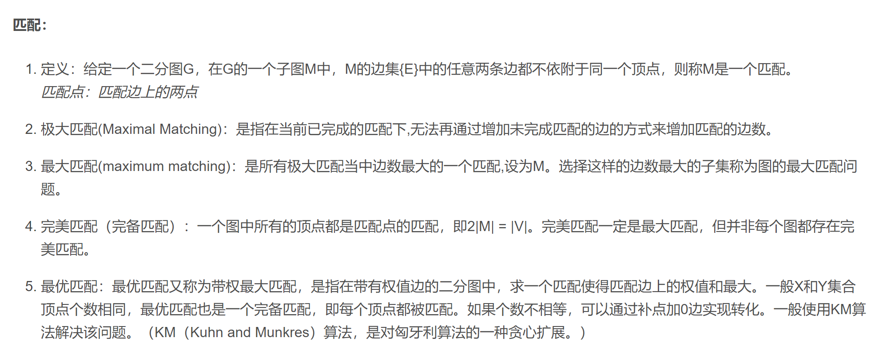
Definition of MCBM

Slide 88
Bipartite Matching
𝑢₁
• Bipartite graph: 𝒢 = 𝒰, 𝒱, ℰ .
• Matching is a subset of edges without common vertices.
• Denote the matching by set 𝖲 ⊆ ℰ.
𝑣₁
𝑢₂
𝑣₂
𝑢₃
𝑣₃
𝑢₄
𝑣₄
Set 𝒱
𝑢₅
Set 𝒰

Slide 89
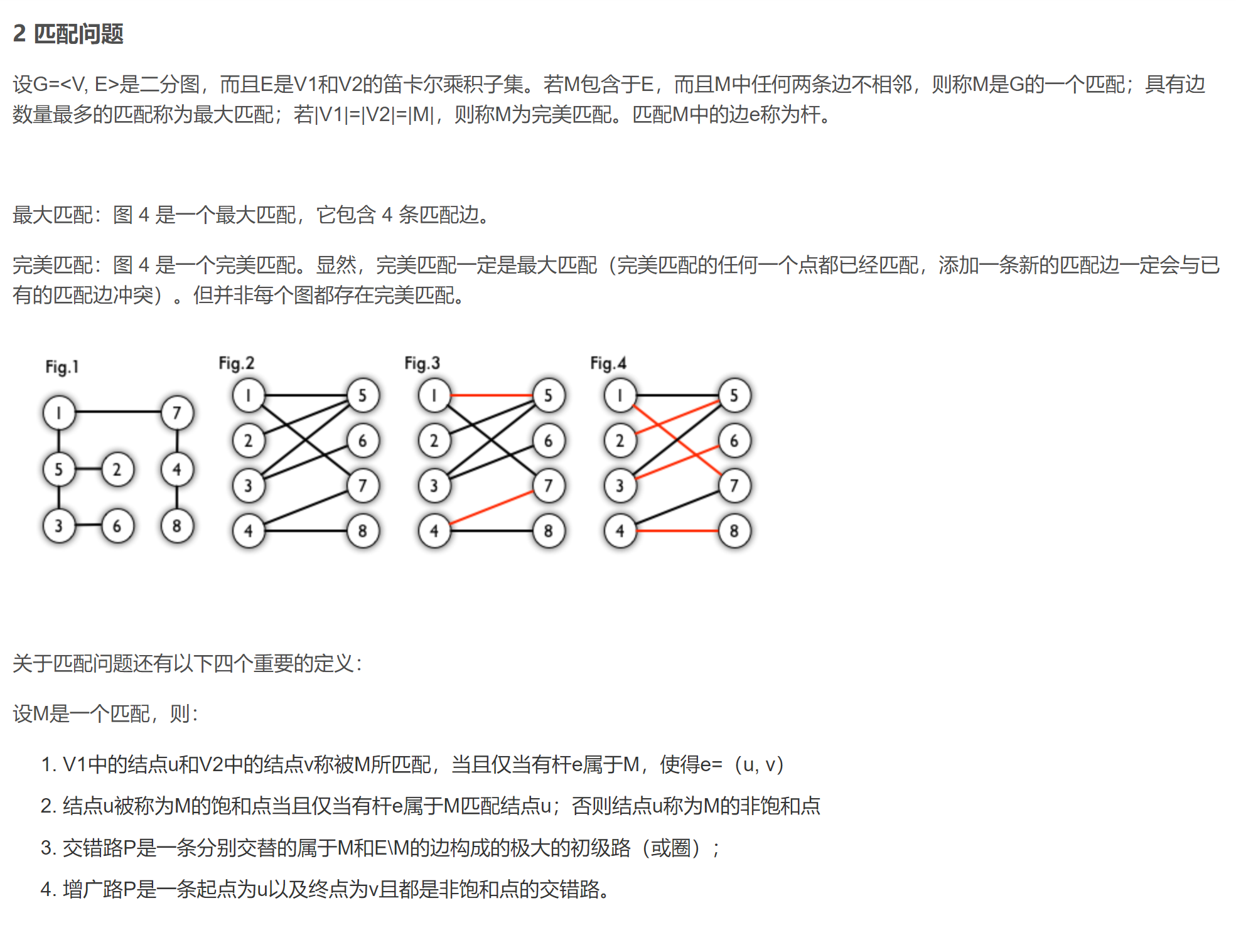
Bipartite Matching
𝑢₁
• 𝖲 = 𝑒₅₁, 𝑒₄₃ is a matching. (But not a maximum matching.)
𝑣₁
𝑢₂
𝑣₂
𝑢₃
𝑣₃
𝑢₄
𝑣₄
Set 𝒱
𝑢₅
Set 𝒰

Slide 90
Bipartite Matching
𝑢₁
• 𝖲 = 𝑒₁₁, 𝑒₂₃, 𝑒₄₂, 𝑒₅₄ is a matching.
𝑣₁
𝑢₂
𝑣₂
𝑢₃
𝑣₃
𝑢₄
𝑣₄
Set 𝒱
𝑢₅
Set 𝒰

Slide 91
Bipartite Matching
𝑢₁
• is not a matching.
^{𝑒}13^{, 𝑒}51^{, 𝑒}43
𝑣₁
𝑢₂
• Two edges have common vertex.
𝑣₂
𝑢₃
𝑣₃
𝑢₄
𝑣₄
Set 𝒱
𝑢₅
Set 𝒰
Notes:
1-3 4-3

Slide 92
Maximum-Cardinality Bipartite Matching (MCBM)
𝑢₁
• MCBM: The matching 𝖲 that has the maximum cardinality 𝖲.
𝑣₁
𝑢₂
𝑣₂
𝑢₃
𝑣₃
𝑢₄
𝑣₄
Set 𝒱
𝑢₅
Set 𝒰

Slide 93
Maximum-Cardinality Bipartite Matching (MCBM)
𝑢₁
• MCBM: The matching 𝖲 that has the maximum cardinality 𝖲 .
𝑣₁
𝑢₂
• MCBM may not be unique.
𝑣₂
𝑢₃
𝑣₃
𝑢₄
𝑣₄
Set 𝒱
𝑢₅
Set 𝒰

Slide 94
Maximum-Cardinality Bipartite Matching (MCBM)
𝑢₁
• MCBM: The matching 𝖲 that has the maximum cardinality 𝖲 .
𝑣₁
𝑢₂
• MCBM may not be unique.
𝑣₂
𝑢₃
𝑣₃
𝑢₄
𝑣₄
Set 𝒱
𝑢₅
Set 𝒰

Slide 95
Greedy Algorithm

Slide 96
People
Pets
Pet adoption
Alice
• Bipartite graph: 𝒢 = 𝒰, 𝒱, ℰ .
• Set 𝒰 contains people.
• Set 𝒱 contains pets.
• Edges in ℰ are people’s preference.
• Goal: Maximizing the cardinality of matching.
Bob
Chris
David
Emma

Slide 97
People
Pets
Pet adoption
Alice
• The cardinality of the maximum matching is 5.
Bob
Chris
David
Emma

Slide 98
People
Pets
Greedy Algorithm
Alice
Bob
Chris
David
Emma

Slide 99
People
Pets
Greedy Algorithm
Alice
Bob
Chris
David
Emma

Slide 100
People
Pets
Greedy Algorithm
Alice
Bob
Chris
David
Emma

Slide 101

People
Pets
Greedy Algorithm
Alice
Bob
Chris
David
Emma

Slide 102

People
Pets
Greedy Algorithm
Alice
Bob
Chris
David
Emma

Slide 103
People
Pets
Greedy Algorithm
Alice
• The cardinality of matching is 4. (Not the maximum.)
Bob
Chris
Greedy algorithm can fail!
David
Emma

Slide 104
Reducing Bipartite Matching to Network Flow

Slide 105
Make the edges directed
Alice
Bob
Chris
David
Emma

Slide 106
Add source and sink
Alice
Bob
𝑠
source
Chris
𝑡
sink
David
Emma

Slide 107
All the edge weights (capacities) are ones
Alice
0/1
0/1
0/1
Bob
0/1
𝑠
source
0/1
0/1
𝑡
sink
Chris
0/1
0/1
David
0/1
0/1
Emma

Slide 108
Find the max-flow using any algorithm
Alice
0/1
0/1
0/1
Bob
0/1
𝑠
source
0/1
0/1
𝑡
sink
Chris
0/1
0/1
David
0/1
0/1
Emma

Slide 109
capacity of max-flow = cardinality of max-matching
Alice
1/1
1/1
1/1
Bob
1/1
𝑠
source
1/1
1/1
𝑡
sink
Chris
1/1
1/1
David
1/1
1/1
Emma

Slide 110
Summary

Slide 111
Bipartite Matching
𝑢₁
• Bipartite graph: 𝒢 = 𝒰, 𝒱, ℰ .
• Matching is a subset of edges without common vertices.
• Denote the matching by set 𝖲 ⊆ ℰ.
𝑣₁
𝑢₂
𝑣₂
𝑢₃
𝑣₃
𝑢₄
𝑣₄
Set 𝒱
𝑢₅
Set 𝒰

Slide 112
Maximum Cardinality Bipartite Matching (MCBM)
𝑢₁
• Given an unweighted bipartite graph.
• MCBM: Find matching 𝖲 that has the maximum cardinality 𝖲 .
𝑣₁
𝑢₂
𝑣₂
𝑢₃
• Bipartite matching in unweighted graphs is easier than in weighted graphs.
𝑣₃
𝑢₄
𝑣₄
𝑢₅
Set 𝒰
Set 𝒱

Slide 113
Algorithms for finding MCBM
𝑢₁
𝑣₁
• Greedy algorithm can fail.
• Reduce MCBM to the max-flow problem and solve it using any max- flow algorithm.
𝑢₂
𝑣₂
𝑢₃
𝑣₃
𝑢₄
𝑣₄
𝑢₅
Set 𝒰
Set 𝒱

Slide 114
Maximum-Weight Bipartite Matching 最大权重匹配

Slide 115
Weighted Bipartite Graph
𝑢₁
4
3
• Bipartite graph: 𝒢 = 𝒰, 𝒱, ℰ .
𝑣₁
• Edges have weights:
𝑤_{𝑖j}.
𝑢₂
5
2
𝑣₂
𝑢₃
4
4
3
5
2
𝑣₃
𝑢₄
𝑣₄
Set 𝒱
𝑢₅
Set 𝒰

Slide 116
Weighted Bipartite Graph
• Bipartite graph: 𝒢 = 𝒰, 𝒱, ℰ .
• Edges have weights: 𝑤_{𝑖j}.
• Adjacency matrix:
𝑢₁
4
3
𝑣₁
𝑢₂
5
2
𝑣₂
 | 𝑣₁ | 𝑣₂ | 𝑣₃ | 𝑣₄
𝑢₁ | 4 | 0 | 3 | 0
𝑢₂ | 0 | 0 | 5 | 0
𝑢₃ | 2 | 0 | 4 | 0
𝑢₄ | 0 | 4 | 3 | 0
𝑢₅ | 5 | 0 | 0 | 2
𝑢
4
3
4
3
5
2
𝑣₃
𝑢₄
𝑣₄
Set 𝒱
𝑢₅
Set 𝒰

Slide 117
Bipartite Matching in Weighted Graph
𝑢₁
4
3
𝑣₁
• Bipartite graph: 𝒢 = 𝒰, 𝒱, ℰ .
• Matching is a subset of edges without common vertices.
• Denote the matching by set 𝖲 ⊆ ℰ.
𝑢
2
5
2
𝑣₂
𝑢₃
4
4
𝑣₃
𝑢₄
3
5
2
𝑣₄
Set 𝒱
𝑢₅
Set 𝒰

Slide 118
Bipartite Matching in Weighted Graph
𝑢₁
4
3
• Sum of weights in matching 𝖲:
𝑣₁
𝑢
𝑓 𝖲
= ∑
𝑤_{𝑢𝑣}.
2
5
2
𝑢,𝑣 ∈𝖲
𝑣₂
𝑢₃
4
4
𝑣₃
𝑢₄
3
5
2
𝑣₄
Set 𝒱
𝑢₅
Set 𝒰

Slide 119
Bipartite Matching in Weighted Graph
𝑢₁
4
3
• Sum of weights in matching 𝖲:
𝑣₁
𝑢
𝑓 𝖲
= ∑
𝑤_{𝑢𝑣}.
2
5
2
𝑢,𝑣 ∈𝖲
𝑣₂
• In this example,
𝑓 𝖲 = 3 + 4 + 5 = 12.
𝑢₃
4
4
𝑣₃
𝑢₄
3
5
2
𝑣₄
Set 𝒱
𝑢₅
Set 𝒰

Slide 120
Bipartite Matching in Weighted Graph
𝑢₁
4
3
• Sum of weights in matching 𝖲:
𝑣₁
𝑢
𝑓 𝖲
= ∑
𝑤_{𝑢𝑣}.
2
5
2
𝑢,𝑣 ∈𝖲
𝑣₂
• In this example,
𝑓 𝖲 = 4 + 5 + 4 + 2 = 15.
𝑢₃
4
4
3
5
2
𝑣₃
𝑢₄
𝑣₄
Set 𝒱
𝑢₅
Set 𝒰

Slide 121
Maximum-Weight Bipartite Matching
𝑢₁
4
3
• Sum of weights in matching 𝖲:
𝑣₁
𝑢
𝑓 𝖲
= ∑
𝑤_{𝑢𝑣}.
2
5
2
𝑢,𝑣 ∈𝖲
𝑣₂
𝑢₃
4
• Objective: Finding matching 𝖲 that has the maximum sum of weights:
4
3
5
2
𝑣₃
𝑢₄
max 𝑓 𝖲 .
𝑣
4
𝖲
𝑢
5
Set 𝒱
Set 𝒰

Slide 122
Application 1: Match candidates and positions
Candidates Positions
• Edge weights quantify candidates’ skills.
• Maximize the weights of matching. (Match the right person with the right job position to maximize the company’s interest.)
Alice
3
5
2
1
Bob
4
3
Chris
5
2
5
David

Slide 123
Application 2: Pet adoptions
• An edge weight quantifies how much a person loves a pet.
• Maximize the weights of matching. (Maximize people’s happiness.)
People
Pets
Alice
3
5
2
Bob
₄ 1
3
Chris
5
2
5
David

Slide 124
Application 3: Dating
• An edge weight quantifies how well two persons match (e.g., similar hoppy).
• Maximize the weights of matching. (Maximize the change of success.)
Man
Women
Alex
Alice
3
5
2
1
Bob
Becky
4
3
Chris
5
2
5
Cindy
David
Diana

Slide 125

Minimum Matching
Maximum Matching

Slide 126
Maximum Matching
People
Pets
• Adopting a pet can bring happiness to people.
• A weight quantifies how much a person loves a pet.
• Maximize the weights of matching. (Maximize people’s happiness.)
Alice
3
5
2
1
Bob
4
3
Chris
5
2
5
David

Slide 127
Minimum Matching
People
Pets
• Adopting a pet can cost time and money.
• A weight quantifies how a person dislike a pet.
• Minimize the weights of matching. (Maximize people’s happiness.)
Alice
2
−5
−2
Bob
−1
−4
−3
Chris
1
3
David
−5

Slide 128

Maximum Matching
Minimum Matching
People Pets
• If we have an algorithm for finding minimum matching.
• Then we can use it for finding maximum matching.
Alice
3
5
2
Bob
₄ 1
3
Chris
5
2
5
David

Slide 129
Maximum Matching
Minimum Matching
People Pets
• If we have an algorithm for finding minimum matching.
• Then we can use it for finding maximum matching.
1. Flip the signs of all the weights.
2. Run the minimum matching algorithm.
Alice
−3
−5
−2
Bob
−1
−4
−3
Chris
−5
−2
David
−5

Slide 130
Hungarian Algorithm

Slide 131
Hungarian Algorithm
• Hungarian algorithm is for finding the minimum-weight bipartite matching.
• On the graph, the cardinality of 𝒰 and 𝒱 must be the same:
𝒰 = |𝒱| = 𝑛.
Reference:
• Harold W. Kuhn. The Hungarian Method for the assignment problem. Naval Research Logistics Quarterly, 2: 83–97, 1955.

Slide 132
Hungarian Algorithm
• Hungarian algorithm is for finding the minimum-weight bipartite matching.
• On the graph, the cardinality of 𝒰 and 𝒱 must be the same:
𝒰 = |𝒱| = 𝑛.
• Time complexity: 𝑂 𝑛³ .
Reference:
• Harold W. Kuhn. The Hungarian Method for the assignment problem. Naval Research Logistics Quarterly, 2: 83–97, 1955.

Slide 133
Hungarian Algorithm
• Hungarian algorithm is for finding the minimum-weight bipartite matching.
• How to solve maximum-weight bipartite matching?
• Flip the signs of all the weights.
• On the new graph, run the Hungarian algorithm to find the minimum-matching.
• The outcome is the maximum-matching on the original graph.

Slide 134
Minimum-Weight Bipartite Matching

Slide 135
Minimum-Weight Bipartite Matching
𝑣₁ 𝑣₂ 𝑣₃
𝑢₁
8
𝑣₁
25
8 | 25 | 50
50 | 35 | 75
22 | 48 | 150
50
𝑢₁
𝑢₂
𝑢₃
50
_{𝑢2} 35 _{𝑣2}
75
22
48
𝑢 𝑣
3 3
150
Set 𝒰
Set 𝒱

Slide 136
Minimum-Weight Bipartite Matching
𝑣₁ 𝑣₂ 𝑣₃
𝑢₁
8
𝑣₁
25
8 | 25 | 50
50 | 35 | 75
22 | 48 | 150
50
𝑢₁
𝑢₂
𝑢₃
50
35
𝑢₂
𝑣₂
75
22
48
𝑢
𝑣
3
150
3
Set 𝒰
Set 𝒱
The minimum sum of weight is 50 + 35 + 22 = 107.

Slide 137
Subtract Row Minima
𝑣₁ 𝑣₂ 𝑣₃
𝑢₁
𝑢₂
𝑢₃
8 | 25 | 50
50 | 35 | 75
22 | 48 | 150

Slide 138
Subtract Row Minima
𝑣₁ 𝑣₂ 𝑣₃
𝑢₁
𝑢₂
𝑢₃
8 | 25 | 50
50 | 35 | 75
22 | 48 | 150
8
35
22

Slide 139
Subtract Row Minima
𝑣₁ 𝑣₂ 𝑣₃
𝑢₁
𝑢₂
𝑢₃
8 -8 | 25 -8 | 50 -8
50 -35 | 35 -35 | 75 -35
22 -22 | 48 -22 | 150 -22
8
35
22

Slide 140
Subtract Row Minima
𝑣₁ 𝑣₂ 𝑣₃
0 | 17 | 42
15 | 0 | 40
0 | 26 | 128
𝑢₁
𝑢₂
𝑢₃
0
Now, the row minima are zeros.
0
0

Slide 141
Subtract Column Minima
𝑣₁ 𝑣₂ 𝑣₃
𝑢₁
𝑢₂
𝑢₃
0 | 17 | 42
15 | 0 | 40
0 | 26 | 128

Slide 142
Subtract Column Minima
𝑣₁ 𝑣₂ 𝑣₃
𝑢₁
𝑢₂
𝑢₃
0 | 17 | 42
15 | 0 | 40
0 | 26 | 128
0
0
40

Slide 143
Subtract Column Minima
𝑣₁ 𝑣₂ 𝑣₃
𝑢₁
𝑢₂
𝑢₃
0 -0 | 17 -0 | 42 -40
15 -0 | 0 -0 | 40 -40
0 -0 | 26 -0 | 128 -40
0
0
40

Slide 144
Subtract Column Minima
𝑣₁ 𝑣₂ 𝑣₃
0 | 17 | 2
15 | 0 | 0
0 | 26 | 88
𝑢₁
𝑢₂
𝑢₃
0
Now, the column minima are zeros.
0
0

Slide 145


Iteration 1
𝑣₁ 𝑣₂ 𝑣₃
Repeat the followings:
0 | 17 | 2
15 | 0 | 0
0 | 26 | 88
𝑢₁
𝑢₂
𝑢₃
A. Cover all the zeros with a minimum number of lines.
B. Decide whether to stop.
C. Create additional zeros.

Slide 146
Iteration 1A
𝑣₁ 𝑣₂ 𝑣₃
Repeat the followings:
 | 0 | 17 | 2
 | 15 | 0 | 0
 | 0 | 26 | 88
𝑢₁
𝑢₂
𝑢₃
A. Cover all the zeros with a minimum number of lines.
B. Decide whether to stop.
C. Create additional zeros.

Slide 147
Iteration 1A
𝑣₁ 𝑣₂ 𝑣₃
Repeat the followings:
 | 0 | 17 | 2
 | 15 | 0 | 0
 | 0 | 26 | 88
𝑢₁
𝑢₂
𝑢₃
A. Cover all the zeros with a minimum number of lines.
B. Decide whether to stop.
C. Create additional zeros.
Not optimal!

Slide 148
Iteration 1A
𝑣₁ 𝑣₂ 𝑣₃
Repeat the followings:
 |  |  | 17 | 2
 |  | 0
 | 15 |  | 0 | 0
 |  | 0 | 26 | 88
𝑢₁
𝑢₂
𝑢₃
A. Cover all the zeros with a minimum number of lines.
B. Decide whether to stop.
C. Create additional zeros.

Slide 149

Iteration 1B
𝑣₁ 𝑣₂ 𝑣₃
Repeat the followings:
 |  |  | 17 | 2
 |  | 0
 | 15 |  | 0 | 0
 |  | 0 | 26 | 88
𝑢₁
𝑢₂
𝑢₃
A. Cover all the zeros with a minimum number of lines.
B. Decide whether to stop.
C. Create additional zeros.
• If 𝑛 lines are required, the algorithm stops. n = 3 in this graph
• If less than 𝑛 lines are required, then continue with Step C.

Slide 150
Iteration 1C
𝑣₁ 𝑣₂ 𝑣₃
Repeat the followings:
 |  |  | 17 | 2
 |  | 0
 | 15 |  | 0 | 0
 |  | 0 | 26 | 88
𝑢₁
𝑢₂
𝑢₃
A. Cover all the zeros with a minimum number of lines.
B. Decide whether to stop.
C. Create additional zeros.
First, find the smallest element (denote
𝑘) that is not covered by a line.

Slide 151
Iteration 1C
𝑣₁ 𝑣₂ 𝑣₃
Repeat the followings:
17
2
=k
𝑢₁
𝑢₂
𝑢₃
0
2
A. Cover all the zeros with a minimum number of lines.
B. Decide whether to stop.
C. Create additional zeros.
15 0 0
26
88
0
First, find the smallest element (denote
𝑘) that is not covered by a line.

Slide 152
Iteration 1C
𝑣₁ 𝑣₂ 𝑣₃
Repeat the followings:
17
-2
𝑢₁
𝑢₂
𝑢₃
0
2
A. Cover all the zeros with a minimum number of lines.
B. Decide whether to stop.
C. Create additional zeros.
-2
15 0 0
26
-2
88
-2
0
Second, subtract 𝑘 from all uncovered elements.

Slide 153
Iteration 1C
𝑣₁ 𝑣₂ 𝑣₃
Repeat the followings:
 |  |  | 15 | 0
 |  | 0
 | 15 |  | 0 | 0
 |  | 0 | 24 | 86
𝑢₁
𝑢₂
𝑢₃
0
A. Cover all the zeros with a minimum number of lines.
B. Decide whether to stop.
C. Create additional zeros.
Second, subtract 𝑘 from all uncovered elements.

Slide 154
Iteration 1C
𝑣₁ 𝑣₂ 𝑣₃
Repeat the followings:
 |  |  | 15 | 0
 |  | 0
 | 15 |  | 0 | 0
 |  | +2
 |  | 0 | 24 | 86
𝑢₁
𝑢₂
𝑢₃
A. Cover all the zeros with a minimum number of lines.
B. Decide whether to stop.
C. Create additional zeros.
15
Third, add 𝑘 to all the elements that are covered twice.

Slide 155
Iteration 1C
𝑣₁ 𝑣₂ 𝑣₃
Repeat the followings:
 |  |  | 15 | 0
 |  | 0
 | 17 |  | 0 | 0
 |  | 0 | 24 | 86
𝑢₁
𝑢₂
𝑢₃
A. Cover all the zeros with a minimum number of lines.
B. Decide whether to stop.
C. Create additional zeros.
17
Third, add 𝑘 to all the elements that are covered twice.

Slide 156
Iteration 2
𝑣₁ 𝑣₂ 𝑣₃
Repeat the followings:
0 | 15 | 0
17 | 0 | 0
0 | 24 | 86
𝑢₁
𝑢₂
𝑢₃
A. Cover all the zeros with a minimum number of lines.
B. Decide whether to stop.
C. Create additional zeros.

Slide 157
Iteration 2A
𝑣₁ 𝑣₂ 𝑣₃
Repeat the followings:
0 | 15 | 0
17 | 0 | 0
0 | 24 | 86
𝑢₁
𝑢₂
𝑢₃
A. Cover all the zeros with a minimum number of lines.
B. Decide whether to stop.
C. Create additional zeros.

Slide 158
Iteration 2A
𝑣₁ 𝑣₂ 𝑣₃
Repeat the followings:
𝑢₁
𝑢₂
𝑢₃
0 15 0
A. Cover all the zeros with a minimum number of lines.
B. Decide whether to stop.
C. Create additional zeros.
17 0 0
24
86
0
At least 3 lines are needed.

Slide 159
Iteration 2B
𝑣₁ 𝑣₂ 𝑣₃
Repeat the followings:
𝑢₁
𝑢₂
𝑢₃
0 15 0
A. Cover all the zeros with a minimum number of lines.
B. Decide whether to stop.
C. Create additional zeros.
17 0 0
24
86
0
If 𝑛 lines are required, the algorithm stops.
The algorithm stops.

Slide 160
Output the matching
𝑣₁ 𝑣₂ 𝑣₃
𝑢₁
𝑢₂
𝑢₃
0 | 15 | 0
17 | 0 | 0
0 | 24 | 86

Slide 161
Output the matching
𝑣₁ 𝑣₂ 𝑣₃
𝑢₁
𝑢₂
𝑢₃
0 | 15 | 0
17 | 0 | 0
0 | 24 | 86
• Choose a matching among the zeros.
• Think of the zeros as edges.

Slide 162
Output the matching
𝑣₁ 𝑣₂ 𝑣₃
𝑢₁
𝑣₁
0 | 15 | 0
17 | 0 | 0
0 | 24 | 86
𝑢₁
𝑢₂
𝑢₃
𝑢₂
𝑣₂
𝑢
𝑣
3
3
Set 𝒰
Set 𝒱
• Choose a matching among the zeros.
• Think of the zeros as edges.

Slide 163
Output the matching
𝑣₁ 𝑣₂ 𝑣₃
𝑢₁
𝑣₁
0 | 15 | 0
17 | 0 | 0
0 | 24 | 86
𝑢₁
𝑢₂
𝑢₃
𝑢₂
𝑣₂
𝑢
𝑣
3
3
Set 𝒰
Set 𝒱

Slide 164
Output the matching
𝑣₁ 𝑣₂ 𝑣₃
𝑢₁
𝑣₁
0 | 15 | 0
17 | 0 | 0
0 | 24 | 86
𝑢₁
𝑢₂
𝑢₃
𝑢₂
𝑣₂
𝑢
𝑣
3
3
Set 𝒰
Set 𝒱

Slide 165
Output the matching
𝑣₁ 𝑣₂ 𝑣₃
0
𝑢₁
15 | 0
0 | 0
𝑢₁
𝑢₂
𝑢₂
𝑣₂
17
𝑢₃
0 24 86
𝑣
3
Set 𝒰
Set 𝒱

Slide 166
Output the matching
𝑣₁ 𝑣₂ 𝑣₃
0
𝑢₁
15 | 0
0 | 0
𝑢₁
𝑢₂
𝑢₂
𝑣₂
17
𝑢₃
0 24 86
𝑣
3
Set 𝒰
Set 𝒱

Slide 167
Output the matching
𝑣₁ 𝑣₂ 𝑣₃
0
𝑢₁
15 | 0
0 | 0
𝑢₁
𝑢₂
𝑢₂
𝑣₂
17
𝑢₃
0 24 86
𝑣
3
Set 𝒰
Set 𝒱

Slide 168
Output the matching
 | 𝑣₃
 | 0
𝑣₁ 𝑣₂
0 15
𝑢₁
𝑢₁
𝑢₂
𝑢₃
17 0 0
0 24 86
𝑣
3
Set 𝒰
Set 𝒱

Slide 169
Output the matching
𝑣₁ 𝑣₂ 𝑣₃
𝑢₁
𝑢₁ | 0 | 15 | 0
𝑢₂ | 17 | 0 | 0
𝑢₃ | 0 | 24 | 86
𝑣
3
Set 𝒰
Set 𝒱

Slide 170
Output the matching
𝑣₁ 𝑣₂ 𝑣₃
𝑢₁
𝑣₁
0 | 15 | 0
17 | 0 | 0
0 | 24 | 86
𝑢₁
𝑢₂
𝑢₃
𝑢₂
𝑣₂
𝑢
𝑣
3
3
Set 𝒰
Set 𝒱
The matching is
𝖲 = 𝑢₃, 𝑣₁ ,
𝑢₁, 𝑣₃ ,
𝑢₂, 𝑣₂ .

Slide 171
Maximum-Weight Bipartite Matching

Slide 172
Maximum Matching
People
Pets
• Pet adoption is a max matching problem.
• A weight quantifies how much a person loves a pet.
• Maximize the weights of matching. (Maximize people’s happiness.)
𝑢₁
𝑣₁
3
5
𝑢₂
2
1
𝑣₂
4
3
𝑢₃
5
2
5
𝑣₃
𝑢₄
𝑣₄

Slide 173
Hungarian Algorithm for Maximum Matching
People Pets
Idea: Max Matching ➡ Min Matching
𝑢₁
𝑣₁
3
• Flip the signs of all the weights.
• It is equivalent to the minimum matching.
• Run the Hungarian algorithm.
5
𝑢₂
2
1
𝑣₂
4
3
𝑢₃
5
2
5
𝑣₃
𝑢₄
𝑣₄

Slide 174
Hungarian Algorithm for Maximum Matching
People Pets
Idea: Max Matching ➡ Min Matching
𝑢₁
𝑣₁
−3
−5
−2
• Flip the signs of all the weights.
• It is equivalent to the minimum matching.
• Run the Hungarian algorithm.
𝑢₂
𝑣₂
−1
−4
−3
𝑢₃
−5
𝑣₃
−2
𝑢₄
𝑣₄
−5

Slide 175
Hungarian Algorithm for Maximum Matching
^{𝑣}1 ^{𝑣}2
𝑣₃ 𝑣₄
People Pets
0 | -3 | -5 | 0
0 | -2 | -1 | -4
-3 | -5 | 0 | 0
0 | 0 | -2 | -5
𝑢₁
𝑣₁
𝑢₁
𝑢₂
𝑢₃
𝑢₄
−3
−5
−2
𝑢₂
𝑣₂
−1
−4
−3
𝑢₃
−5
𝑣₃
−2
𝑢₄
𝑣₄
−5

Slide 176
Subtract Row Minima
^{𝑣}1 ^{𝑣}2
𝑣₃ 𝑣₄
0 | -3 | -5 | 0
0 | -2 | -1 | -4
-3 | -5 | 0 | 0
0 | 0 | -2 | -5
𝑢₁
𝑢₂
𝑢₃
𝑢₄
-5
-4
-5
-5

Slide 177
Subtract Row Minima
^{𝑣}1 ^{𝑣}2
𝑣₃ 𝑣₄
𝑢₁
𝑢₂
𝑢₃ -3 -5 0 0
-(-5) -(-5)
𝑢₄
0 -3 -5 0
-(-5) -(-5)
-5
-(-5)
-(-5)
0 -2
-(-4) -(-4)
-1 -4
-4
-(-4)
-(-4)
-5
-(-5)
-(-5)
0 0 -2 -5
-(-5) -(-5)
-5
-(-5)
-(-5)

Slide 178
Subtract Row Minima
^{𝑣}1 ^{𝑣}2
𝑣₃ 𝑣₄
5 | 2 | 0 | 5
4 | 2 | 3 | 0
2 | 0 | 5 | 5
5 | 5 | 3 | 0
𝑢₁
𝑢₂
𝑢₃
0
Now, the row minima are zeros.
0
0
𝑢₄
0

Slide 179
Subtract Column Minima
^{𝑣}1 ^{𝑣}2
𝑣₃ 𝑣₄
5 | 2 | 0 | 5
4 | 2 | 3 | 0
2 | 0 | 5 | 5
5 | 5 | 3 | 0
𝑢₁
𝑢₂
𝑢₃
𝑢₄

Slide 180
Subtract Column Minima
^{𝑣}1 ^{𝑣}2
𝑣₃ 𝑣₄
5 | 2 | 0 | 5
4 | 2 | 3 | 0
2 | 0 | 5 | 5
5 | 5 | 3 | 0
𝑢₁
𝑢₂
𝑢₃
0
0
2
0
𝑢₄

Slide 181
Subtract Column Minima
^{𝑣}1 ^{𝑣}2
𝑣₃ 𝑣₄
5 -2 | 2 -0 | 0 -0 | 5 -0
4 -2 | 2 -0 | 3 -0 | 0 -0
2 -2 | 0 -0 | 5 -0 | 5 -0
5 -2 | 5 -0 | 3 -0 | 0 -0
𝑢₁
𝑢₂
𝑢₃
0
0
2
0
𝑢₄

Slide 182
Subtract Column Minima
^{𝑣}1 ^{𝑣}2
𝑣₃ 𝑣₄
3 | 2 | 0 | 5
2 | 2 | 3 | 0
0 | 0 | 5 | 5
3 | 5 | 3 | 0
𝑢₁
𝑢₂
𝑢₃
0
Now, the column minima are zeros.
0
0
0
𝑢₄

Slide 183
Iteration 1
^{𝑣}1 ^{𝑣}2
𝑣₃ 𝑣₄
Repeat the followings:
3 | 2 | 0 | 5
2 | 2 | 3 | 0
0 | 0 | 5 | 5
3 | 5 | 3 | 0
𝑢₁
𝑢₂
𝑢₃
A. Cover all the zeros with a minimum number of lines.
B. Decide whether to stop.
C. Create additional zeros.
𝑢₄

Slide 184
Iteration 1A
^{𝑣}1 ^{𝑣}2
𝑣₃ 𝑣₄
Repeat the followings:
𝑢₁
𝑢₂
𝑢₃ 0
3
5
A. Cover all the zeros with a minimum number of lines.
B. Decide whether to stop.
C. Create additional zeros.
2
0
2
2
3
0
5
0
5
𝑢₄
3
5
3
0

Slide 185
Iteration 1B
^{𝑣}1 ^{𝑣}2
𝑣₃ 𝑣₄
Repeat the followings:
𝑢₁
𝑢₂
𝑢₃ 0
3
5
A. Cover all the zeros with a minimum number of lines.
B. Decide whether to stop.
C. Create additional zeros.
2
0
2
2
3
0
5
0
5
• If 𝑛 lines are required, the algorithm stops.
• If less than 𝑛 lines are required, then continue with Step C.
3
5
3
𝑢
0
4

Slide 186
Iteration 1C
^{𝑣}1 ^{𝑣}2
𝑣₃ 𝑣₄
Repeat the followings:
𝑢₁
𝑢₂
𝑢₃ 0
𝑢₄
3
5
A. Cover all the zeros with a minimum number of lines.
B. Decide whether to stop.
C. Create additional zeros.
2
0
2
2
3
0
5
0
5
First, find the smallest element (denote
3
5
3
0
𝑘) that is not covered by a line.

Slide 187
Iteration 1C
^{𝑣}1 ^{𝑣}2
𝑣₃ 𝑣₄
Repeat the followings:
𝑢₁
𝑢₂
𝑢₃ 0
𝑢₄
3
5
A. Cover all the zeros with a minimum number of lines.
B. Decide whether to stop.
C. Create additional zeros.
2
0
2
2
=k
3
2
0
5
0
5
First, find the smallest element (denote
3
5
3
0
𝑘) that is not covered by a line.

Slide 188
Iteration 1C
^{𝑣}1 ^{𝑣}2
𝑣₃ 𝑣₄
Repeat the followings:
𝑢₁
𝑢₂
𝑢₃ 0
𝑢₄
3
5
A. Cover all the zeros with a minimum number of lines.
B. Decide whether to stop.
C. Create additional zeros.
2
0
2
-2
2
-2
3
-2
0
5
0
5
Second, subtract 𝑘 from all uncovered elements.
3
-2
5
-2
3
-2
0

Slide 189
Iteration 1C
^{𝑣}1 ^{𝑣}2
𝑣₃ 𝑣₄
Repeat the followings:
𝑢₁
𝑢₂
𝑢₃ 0
𝑢₄
3
5
A. Cover all the zeros with a minimum number of lines.
B. Decide whether to stop.
C. Create additional zeros.
2
0
0
0
1
0
0
5
0
5
Second, subtract 𝑘 from all uncovered elements.
1
3
1
0

Slide 190
Iteration 1C
^{𝑣}1 ^{𝑣}2
𝑣₃ 𝑣₄
Repeat the followings:
𝑢₁
𝑢₂
𝑢₃ 0
3
5
5
A. Cover all the zeros with a minimum number of lines.
B. Decide whether to stop.
C. Create additional zeros.
2
0
+2
0
0
1
0
5
5
0
5
+2
Third, add 𝑘 to all the elements that are covered twice.
𝑢₄
1
3
1
0

Slide 191
Iteration 1C
^{𝑣}1 ^{𝑣}2
𝑣₃ 𝑣₄
Repeat the followings:
𝑢₁
𝑢₂
𝑢₃ 0
3
7
7
A. Cover all the zeros with a minimum number of lines.
B. Decide whether to stop.
C. Create additional zeros.
2
0
0
0
1
0
7
7
0
5
Third, add 𝑘 to all the elements that are covered twice.
𝑢₄
1
3
1
0

Slide 192
Iteration 2
^{𝑣}1 ^{𝑣}2
𝑣₃ 𝑣₄
Repeat the followings:
3 | 2 | 0 | 7
0 | 0 | 1 | 0
0 | 0 | 5 | 7
1 | 3 | 1 | 0
𝑢₁
𝑢₂
𝑢₃
A. Cover all the zeros with a minimum number of lines.
B. Decide whether to stop.
C. Create additional zeros.
𝑢₄

Slide 193
Iteration 2A
^{𝑣}1 ^{𝑣}2
𝑣₃ 𝑣₄
Repeat the followings:
3 | 2 | 0 | 7
0 | 0 | 1 | 0
0 | 0 | 5 | 7
1 | 3 | 1 | 0
𝑢₁
𝑢₂
𝑢₃
A. Cover all the zeros with a minimum number of lines.
B. Decide whether to stop.
C. Create additional zeros.
𝑢₄

Slide 194
Iteration 2A
^{𝑣}1 ^{𝑣}2
𝑣₃ 𝑣₄
Repeat the followings:
𝑢₁
𝑢₂
𝑢₃ 0 0
3 2
7
A. Cover all the zeros with a minimum number of lines.
B. Decide whether to stop.
C. Create additional zeros.
0
1
0 0
0
5
7
𝑢₄
1
3
1
0
At least 4 lines are needed.

Slide 195
Iteration 2B
^{𝑣}1 ^{𝑣}2
𝑣₃ 𝑣₄
Repeat the followings:
𝑢₁
𝑢₂
𝑢₃ 0 0
𝑢₄
3 2
7
A. Cover all the zeros with a minimum number of lines.
B. Decide whether to stop.
C. Create additional zeros.
0
1
0 0
0
5
7
If 𝑛 lines are required, the algorithm stops.
1
1 3
0
The algorithm stops.

Slide 196
Output the matching
^{𝑣}1 ^{𝑣}2
𝑣₃ 𝑣₄
3 | 2 | 0 | 7
0 | 0 | 1 | 0
0 | 0 | 5 | 7
1 | 3 | 1 | 0
𝑢₁
𝑢₂
𝑢₃
𝑢₄

Slide 197
Output the matching
^{𝑣}1 ^{𝑣}2
𝑣₃ 𝑣₄
People
𝑢₁
Pets
3 | 2 | 0 | 7
0 | 0 | 1 | 0
0 | 0 | 5 | 7
1 | 3 | 1 | 0
𝑣₁
𝑢₁
𝑢₂
𝑢₃
𝑢₂
𝑣₂
𝑢₃
𝑣₃
𝑢₄
𝑣₄
𝑢₄

Slide 198
Output the matching
 | 𝑣₁ | 𝑣₂ | 𝑣₃ | 𝑣₄
𝑢₁ | 3 | 2 | 0 | 7
𝑢₂ | 0 | 0 | 1 | 0
𝑢₃ | 0 | 0 | 5 | 7
People
𝑢₁
Pets
𝑣₁
𝑢₂
𝑣₂
𝑢₃
𝑣₃
𝑢₄
𝑣₄
𝑢₄
1
3
1
0

Slide 199
Output the matching
^{𝑣}1 ^{𝑣}2
𝑣₃
0
1
5
1
𝑣₄
People
𝑢₁
Pets
𝑣₁
𝑢₁ 3 2 7
𝑢₂
𝑢₃
0 | 0
0 | 0
1 | 3
0
7
0
𝑢₂
𝑣₂
𝑢₃
𝑣₃
𝑢₄
𝑣₄
𝑢₄

Slide 200
Output the matching
^{𝑣}1 ^{𝑣}2
𝑣₃
0
1
5
1
𝑣₄
People
Pets
𝑣₁
𝑢₁ 3 2 7
𝑢₂
𝑢₃
0 | 0
0 | 0
1 | 3
0
𝑢₂
𝑣₂
7
𝑢₃
𝑢₄
𝑣₄
𝑢₄
0

Slide 201
Output the matching
 |  | 𝑣₁ | 𝑣₂
𝑣₁
𝑣₂ | 𝑢₂ | 0 | 0
 | 𝑢₃ | 0 | 0
𝑣₃
1
5
1
𝑣₄
0
7
0
People
Pets
𝑢₁ 3 2 0 7
𝑢₂
𝑢₃
𝑢₄
𝑣₄
𝑢₄ 1 3

Slide 202
Output the matching
^{𝑣}1 ^{𝑣}2
𝑣₃ 𝑣₄
0 7
1 0
5 7
1 0
People
Pets
𝑣₁
𝑢₁ 3 2
𝑢₂
𝑢₃
0 | 0
0 | 0
𝑢₂
𝑣₂
𝑢₃
𝑢₄ 1 3

Slide 203
Output the matching
^{𝑣}1 ^{𝑣}2
𝑣₃ 𝑣₄
0 7
1 0
5 7
1 0
People
Pets
𝑣₁
𝑢₁ 3 2
𝑢₂
𝑢₃
0 | 0
0 | 0
𝑢₂
𝑣₂
𝑢₃
𝑢₄ 1 3

Slide 204
Output the matching
^{𝑣}1 ^{𝑣}2
𝑣₃ 𝑣₄
• Return the matching:
𝖲 = 𝑢₁, 𝑣₃ , 𝑢₄, 𝑣₄ , 𝑢₂, 𝑣₁ , 𝑢₃, 𝑣₂ .
3 | 2 | 0 | 7
0 | 0 | 1 | 0
0 | 0 | 5 | 7
1 | 3 | 1 | 0
𝑢₁
𝑢₂
𝑢₃
• Or return the matching:
𝖲 = 𝑢₁, 𝑣₃ , 𝑢₄, 𝑣₄ , 𝑢₃, 𝑣₁ , 𝑢₂, 𝑣₂ .
𝑢₄

Slide 205
Output the matching
^{𝑣}1 ^{𝑣}2
𝑣₃ 𝑣₄
• Return the matching:
𝖲 = 𝑢₁, 𝑣₃ , 𝑢₄, 𝑣₄ , 𝑢₂, 𝑣₁ , 𝑢₃, 𝑣₂ .
3 | 2 | 0 | 7
0 | 0 | 1 | 0
0 | 0 | 5 | 7
1 | 3 | 1 | 0
𝑢₁
𝑢₂
𝑢₃
• Or return the matching:
𝖲 = 𝑢₁, 𝑣₃ , 𝑢₄, 𝑣₄ , 𝑢₃, 𝑣₁ , 𝑢₂, 𝑣₂ .
𝑢₄

Slide 206
Output the matching
• Return the matching:
𝖲 = 𝑢₁, 𝑣₃ , 𝑢₄, 𝑣₄ , 𝑢₂, 𝑣₁ , 𝑢₃, 𝑣₂ .
• The matching is equal to 15.
People
Pets
Alice
5
0
Bob
• Or return the matching:
𝖲 = 𝑢₁, 𝑣₃ , 𝑢₄, 𝑣₄ , 𝑢₃, 𝑣₁ , 𝑢₂, 𝑣₂ .
5
Chris
5
David

Slide 207
Output the matching
• Return the matching:
𝖲 = 𝑢₁, 𝑣₃ , 𝑢₄, 𝑣₄ , 𝑢₂, 𝑣₁ , 𝑢₃, 𝑣₂ .
• The matching is equal to 15.
People
Pets
Alice
5
2
Bob
• Or return the matching:
𝖲 = 𝑢₁, 𝑣₃ , 𝑢₄, 𝑣₄ , 𝑢₃, 𝑣₁ , 𝑢₂, 𝑣₂ .
• The matching is equal to 15.
3
Chris
5
David

Slide 208
Summary

Slide 209
Maximum-Weight Bipartite Matching
• Weighted bipartite graph: 𝒢 = 𝒰, 𝒱, ℰ . (Edges have weights: 𝑤_{𝑢𝑣} .)
• Matching is a subset of edges without common vertices.
• Denote the matching by set 𝖲 ⊆ ℰ.
• Sum of weights in matching 𝖲:
𝑓 𝖲
^{= ∑} 𝑢,𝑣 ∈𝖲 ^{𝑤}𝑢𝑣 .
• Find matching 𝖲 that has the maximum weight:
max 𝑓 𝖲 .
𝖲

Slide 210
Maximum Matching
Minimum Matching
• Maximum matching: max 𝑓 𝖲 .
𝖲
• Minimum matching: min 𝑓 𝖲 .
𝖲
• Maximum matching can be reduced to minimum matching by flipping the signs of weights.
• Algorithms that find the minimum matching can also find the maximum matching.

Slide 211
Hungarian Algorithm
• Hungarian algorithm finds a minimum-weight bipartite matching.
• It requires 𝒰 = |𝒱| = 𝑛.
• Time complexity: 𝑂 𝑛³ .

Slide 212
Questions

Slide 213
𝑣₁ 𝑣₂
Question 1
𝑣₃ 𝑣₄ 𝑣₅
20 | 15 | 18 | 24 | 25
18 | 20 | 12 | 14 | 15
21 | 23 | 25 | 27 | 26
17 | 18 | 21 | 23 | 22
19 | 22 | 16 | 21 | 20
𝑢₁
𝑢₂
𝑢₃
𝑢₄
• The right is the adjacency matrix of a bipartite graph.
• Find the minimum matching on the graph.
𝑢₅

Slide 214
𝑣₁ 𝑣₂
Question 2
𝑣₃ 𝑣₄ 𝑣₅
20 | 15 | 18 | 24 | 25
18 | 20 | 12 | 14 | 15
21 | 23 | 25 | 27 | 26
17 | 18 | 21 | 23 | 22
19 | 22 | 16 | 21 | 20
𝑢₁
𝑢₂
𝑢₃
𝑢₄
• The right is the adjacency matrix of a bipartite graph.
• Find the maximum matching on the graph.
𝑢₅

